Slide 1
Autonomous Target Robot
Francisco Munoz
Taylor Che
Samuel Choi

Slide 2
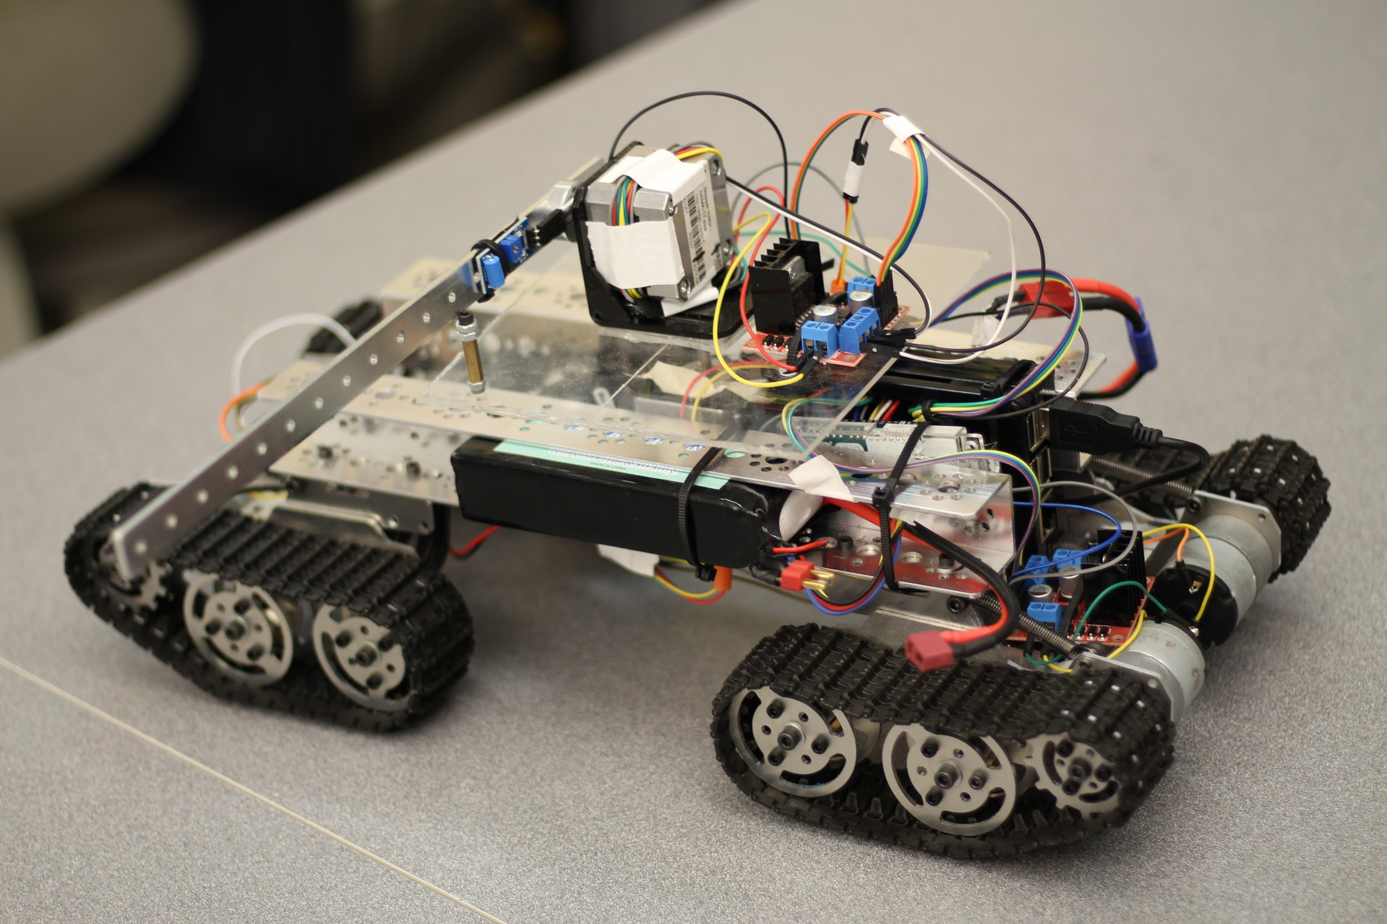
Objectives:
Semi Autonomous Rover
Navigation to designated GPS coordinates
Provide target for shooting & confirmation
Communication via Wifi and SSH

Slide 3
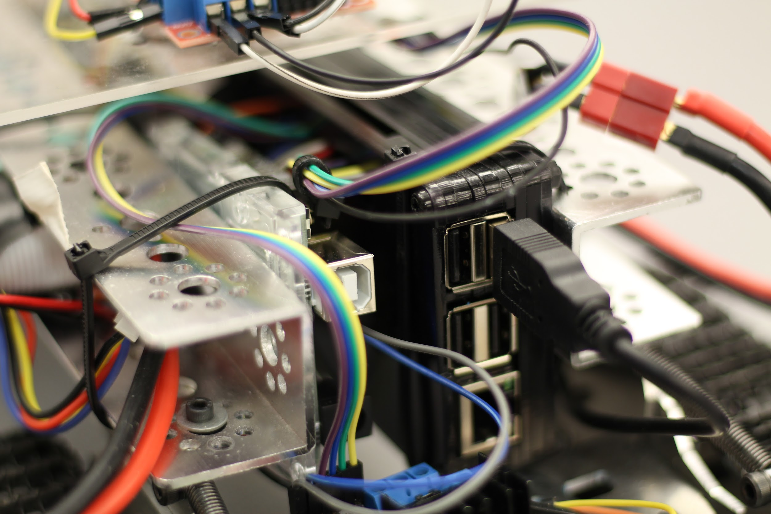
Raspberry Pi 3 Model B
Handles Software and communicates with Arduino via serial port
Controlling turret to face the base using relative location
Utilizes Python to:
Monitor GPS Position
Calculations (Distance, Turning Angle)
DC/Stepper Motor Control + Vibration Sensor
GUI to input GPS Boundaries

Slide 4
Arduino Uno R3
Passively Monitors Functionality
Code Language: C
Monitors IMU
Continuous Turning Cycle Monitoring
Supplies Data to Raspberry Pi 3 via USB

Slide 5
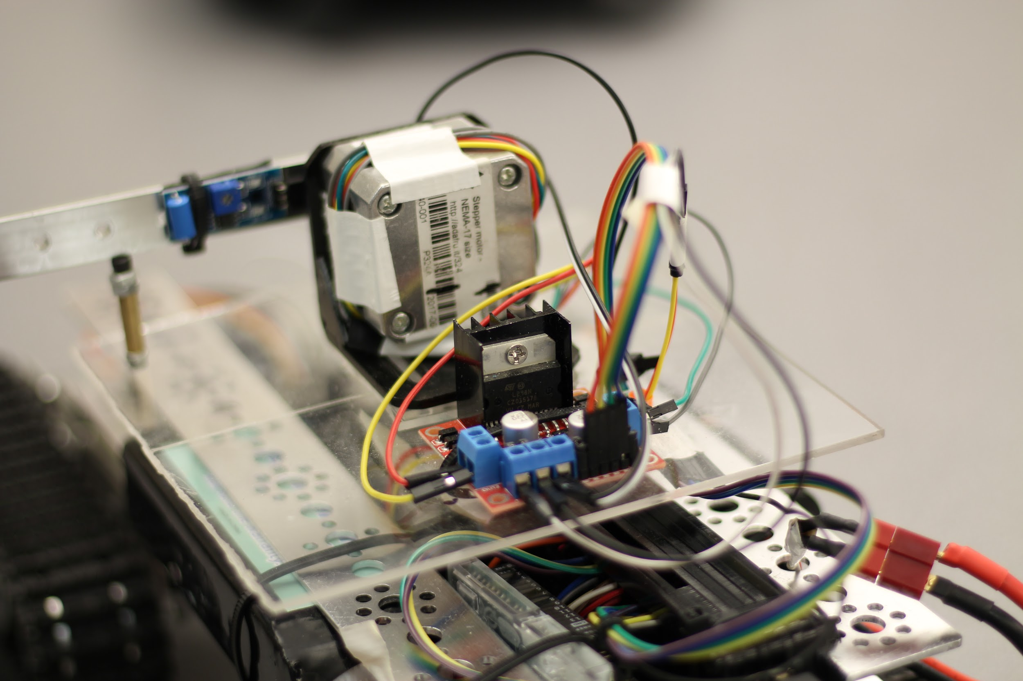
Peripherals:
Turret
Stepper motor rotates to face the GPS position of base relative to the rover
Secondary motor raises and lowers the target arm
Target:
Sensor is affixed to the base if the arm to detect hits for five seconds
Once target is hit, or after five seconds, the Pi will automatically lower the arm

Slide 6
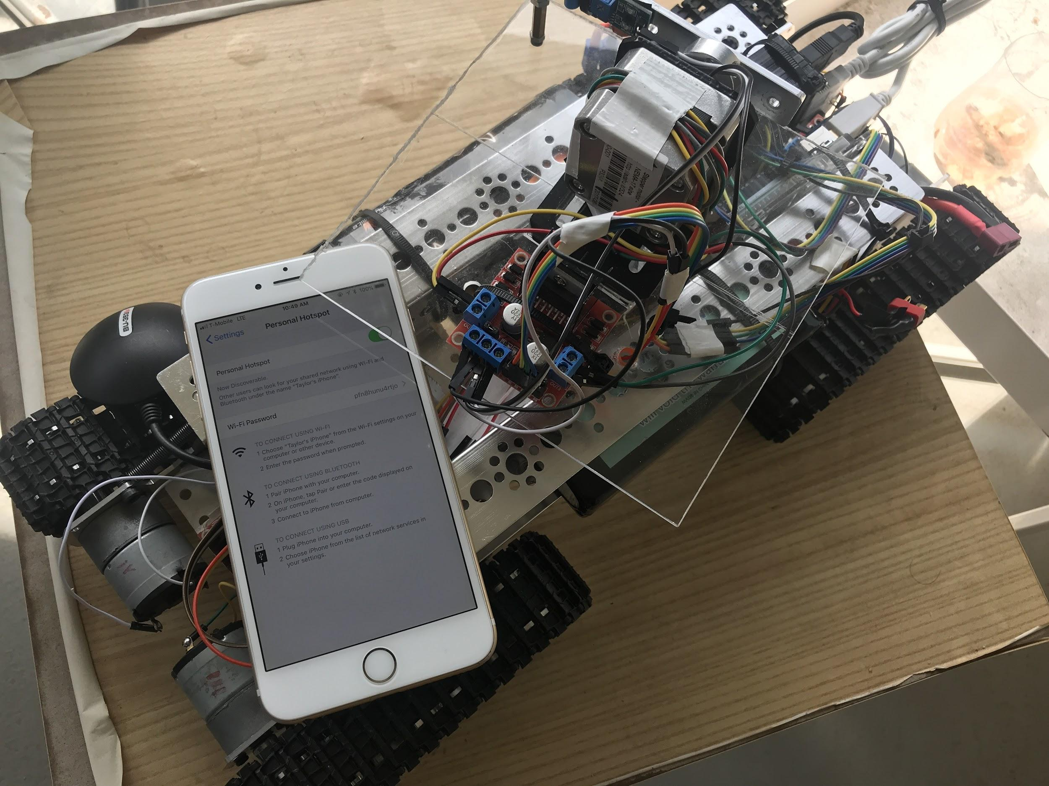
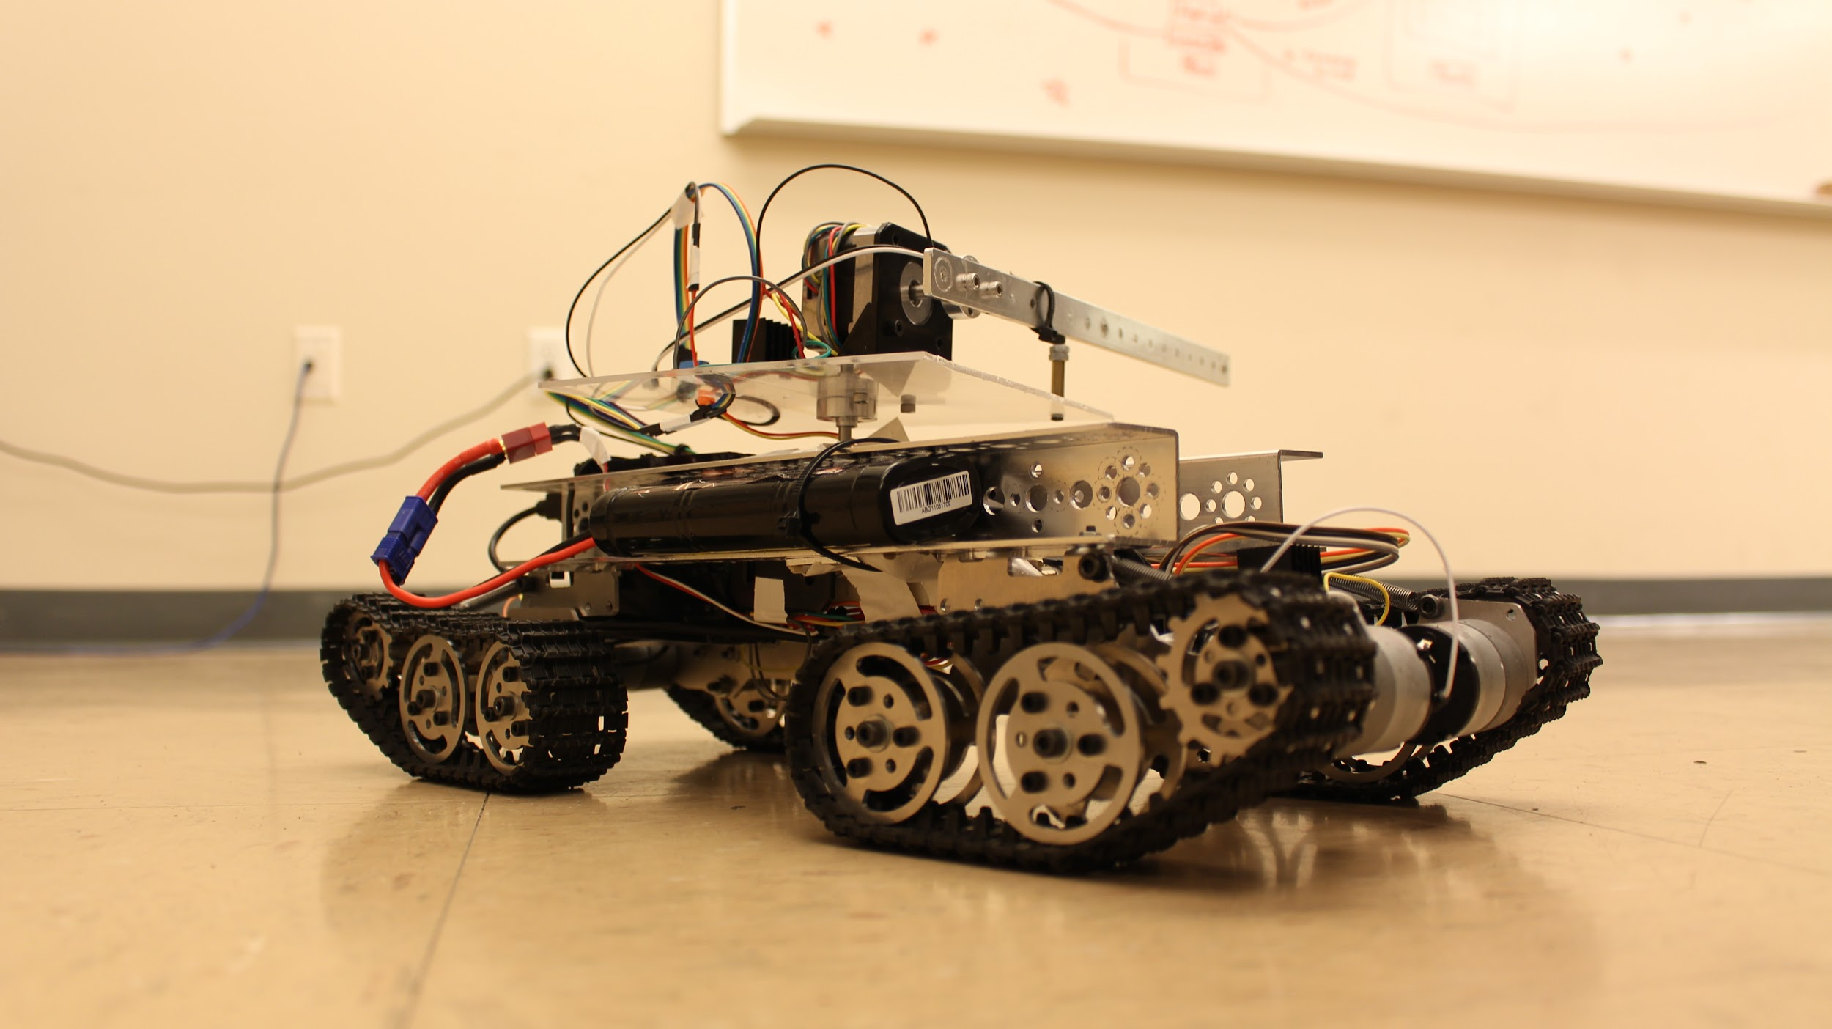
Additional Functionality
Automatic Return to Base
After arriving at all destinations, the rover moves back to starting location
WiFi Connectivity
Pi will be wirelessly connected to base via Cellular Hotspot
Base will connect to the hotspot to relay required information with provided GUI

Slide 7
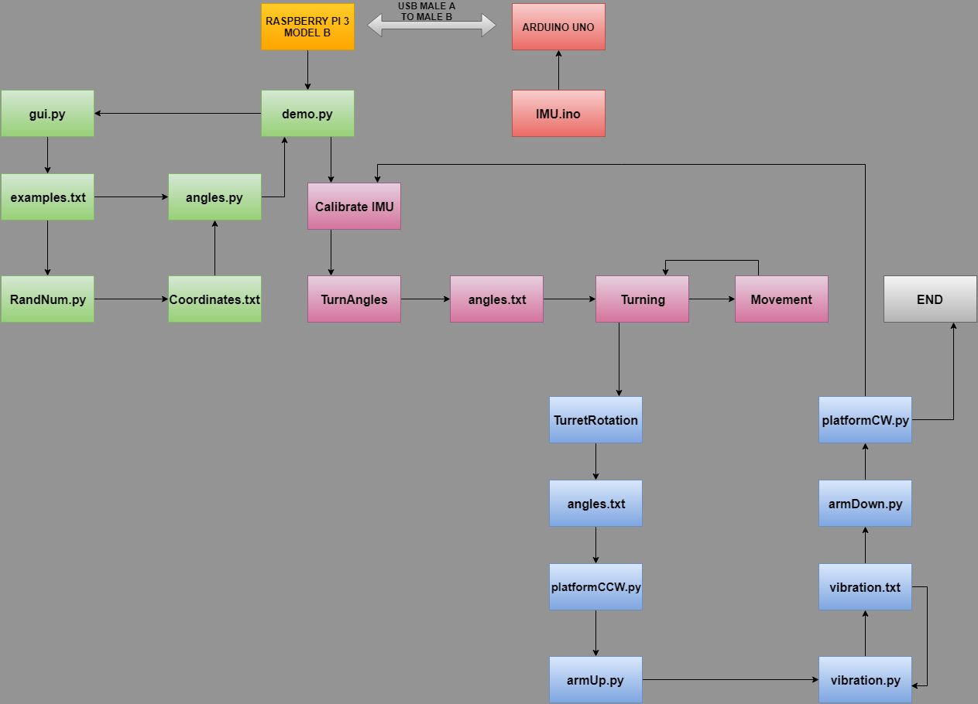
Execution:
Sequential Looped Execution
RPi precomputes angle and approximate distance to destination points, opens serial port and rotates about its current position until desired angle is reached
Activates motor with fixed PWM and pings GPS module to detect current position
Once desired destination is reached, a stop signal is sent
RPi rotates to face North
Turret activates, rotating itself to the origin point
Raises target and waits for five seconds, or upon being hit, lowers the arm
Turret faces back to the front of the bot and restarts from beginning
Upon reaching the final point, the robot turns to face origin and returns to origin point

Slide 8
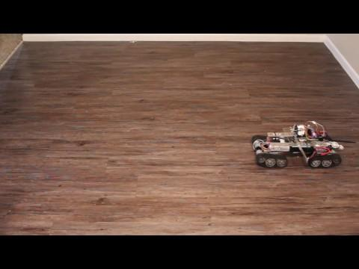

Slide 9
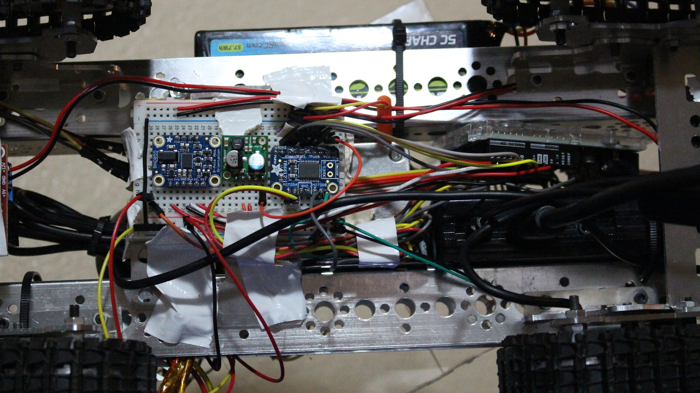
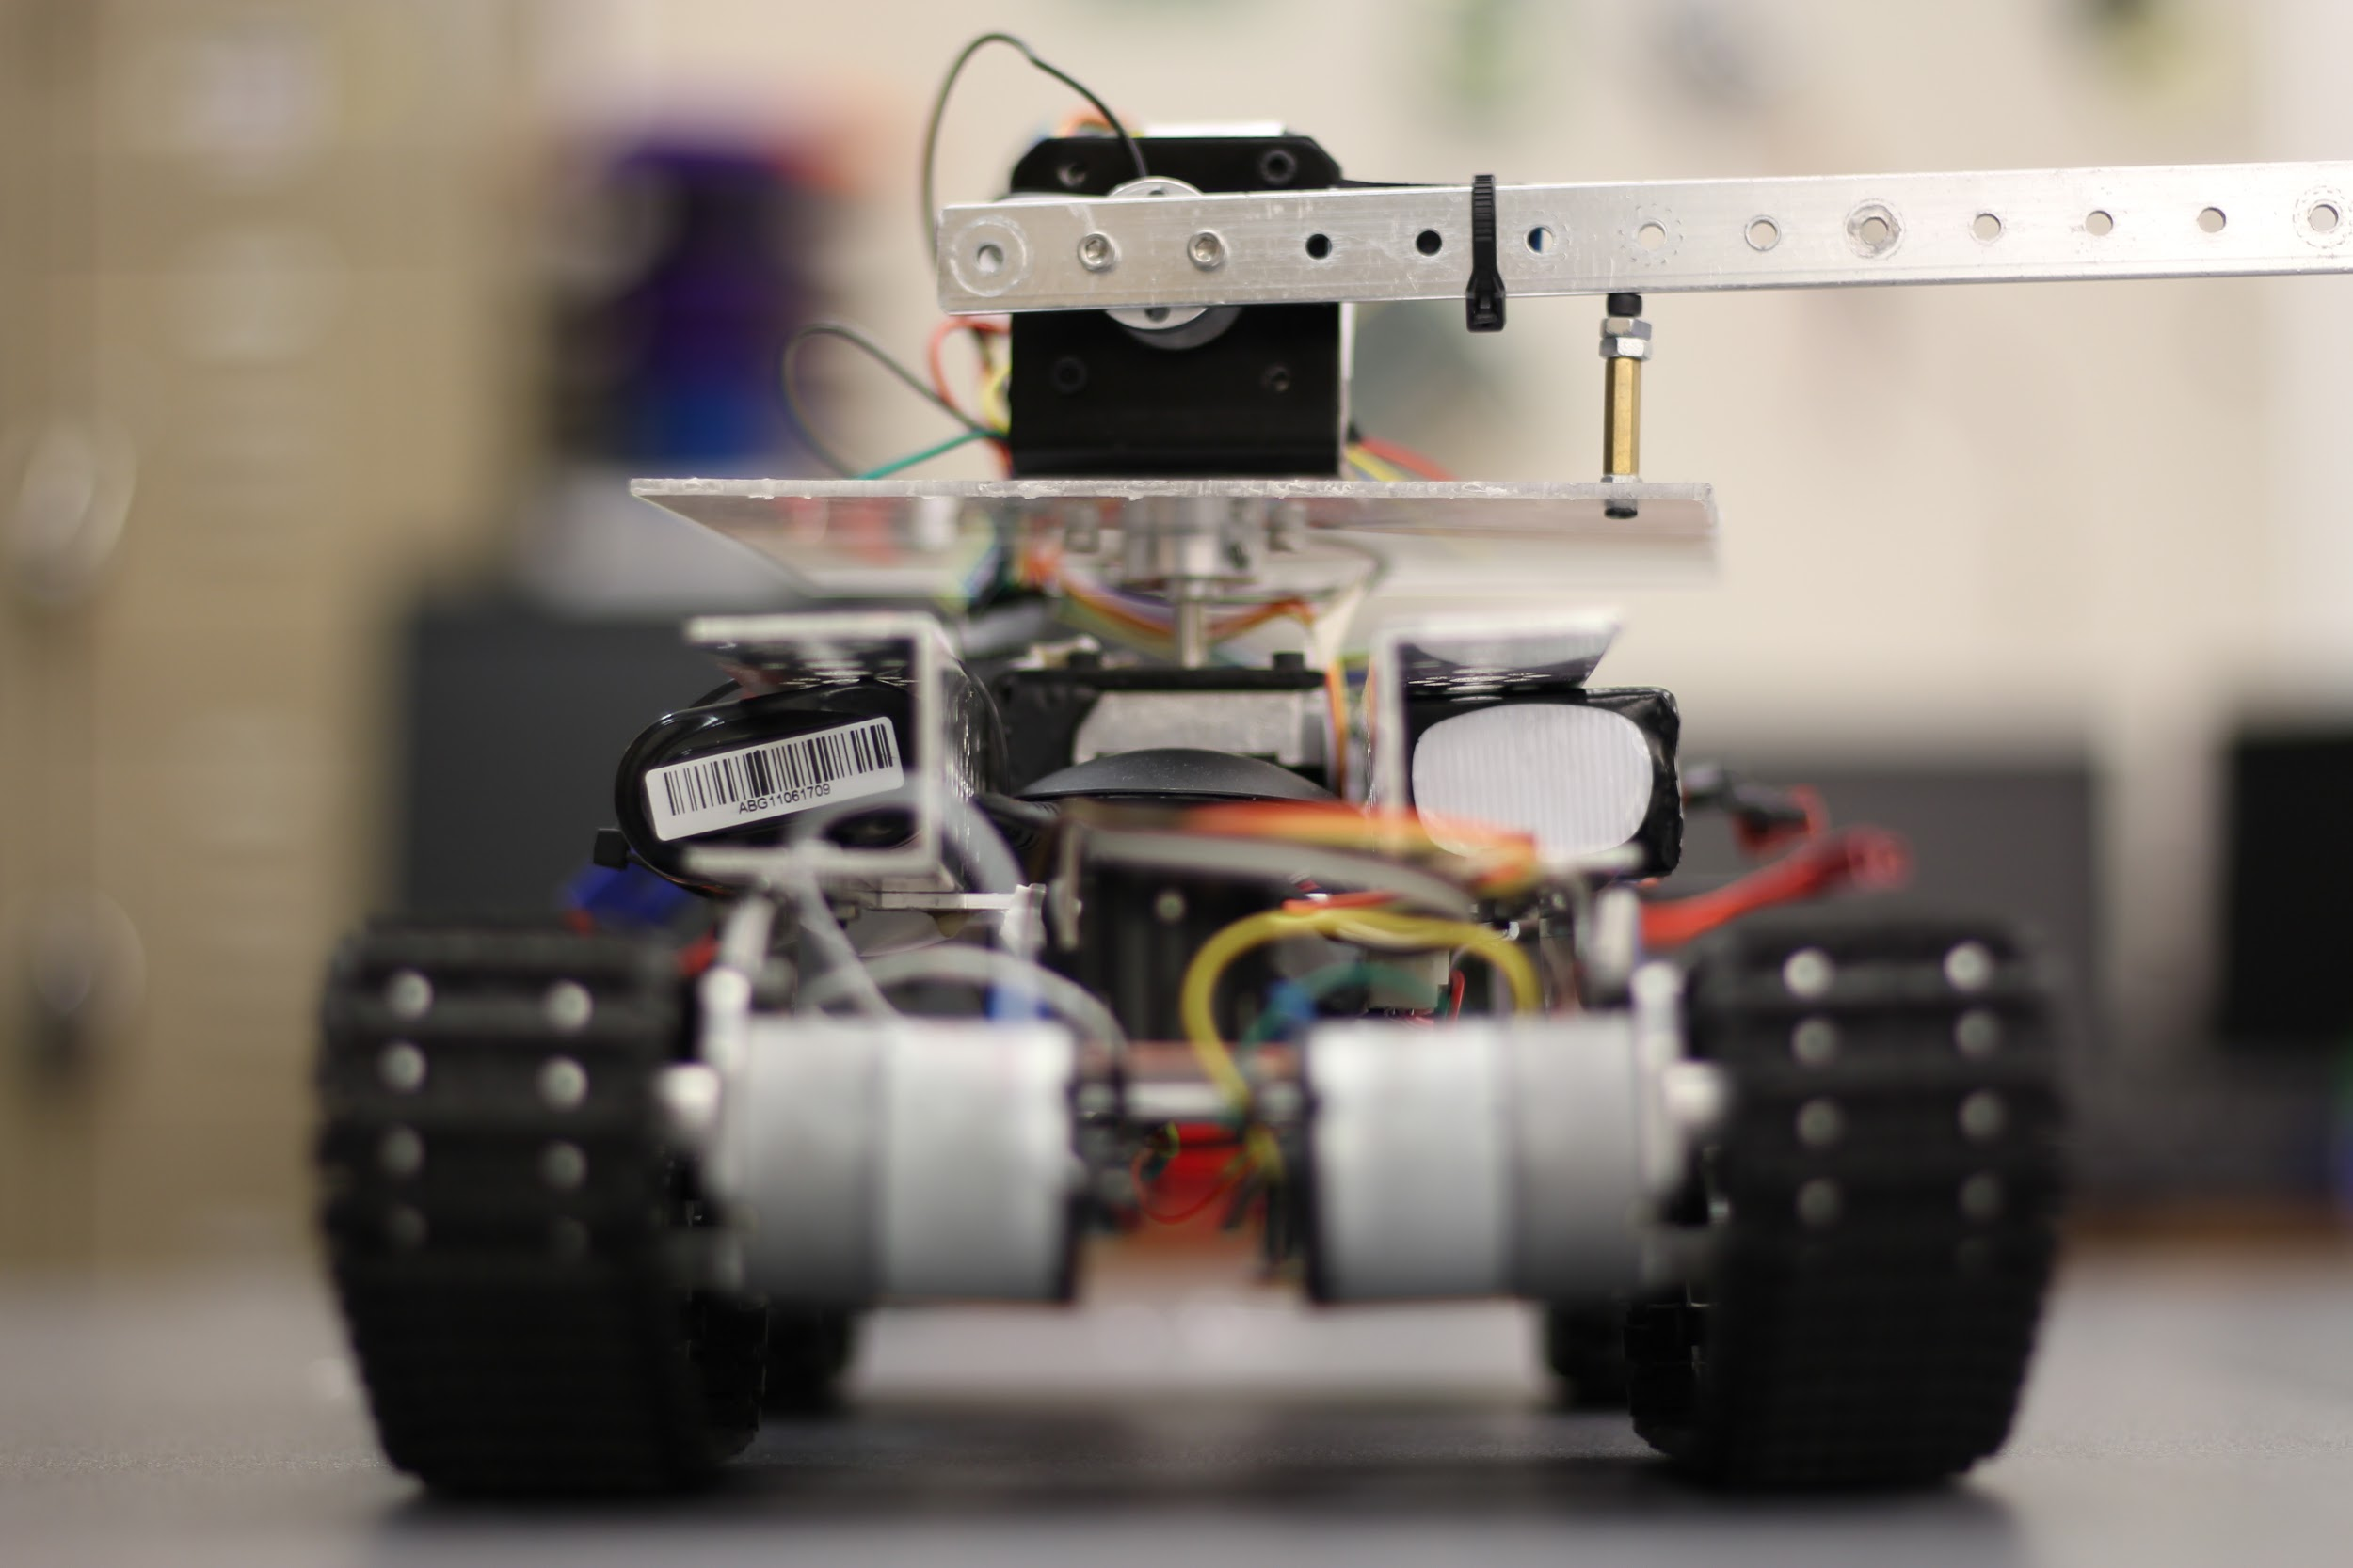
Issues/Solutions
Chassis Constraints
Power Constraints
GPS
IMU-Serial Port Errors

Slide 10
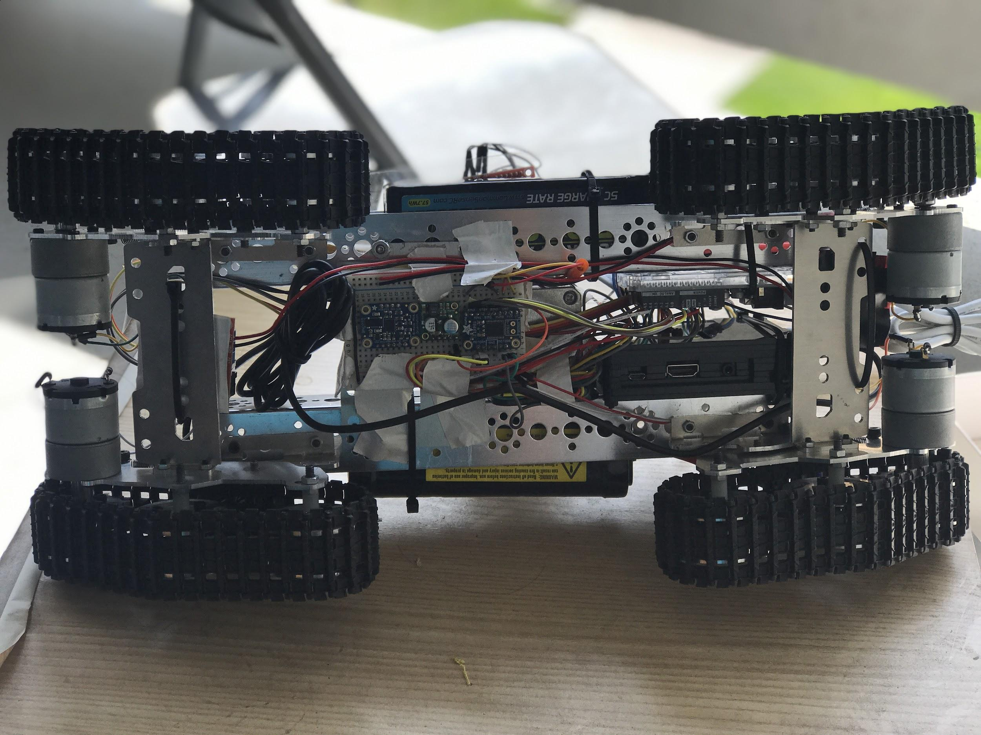
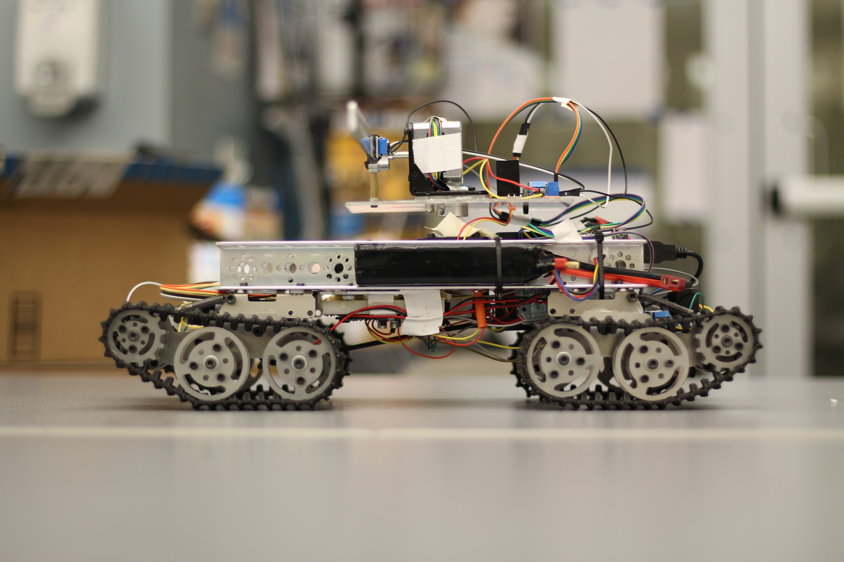
Size Constraints
Chassis Limitations
Track Limitations
IMU Interference
Structural Integrity vs. Modular Chassis
Battery Placement
Motor Control Concessions
IMU vs. Encoders
Wire Interference
Retainer on turret
180° Maximum traverse
Power
Dual Battery Setup to accommodate all peripherals

Slide 11
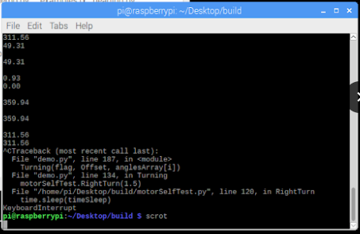
Software
Python Coding
No parallel programming experience
Solved with sequential execution
Introduced Serial Port errors (IMU)
IMU
Serial Communication inconsistent results
Constant execution accurate
Interference through placement
IMU vs. GPS Heading
Requires significant displacement
Solved by rotating about z-axis
GPS v. Hardware
Tracked rover only allows us to function within indoor environments

Slide 12
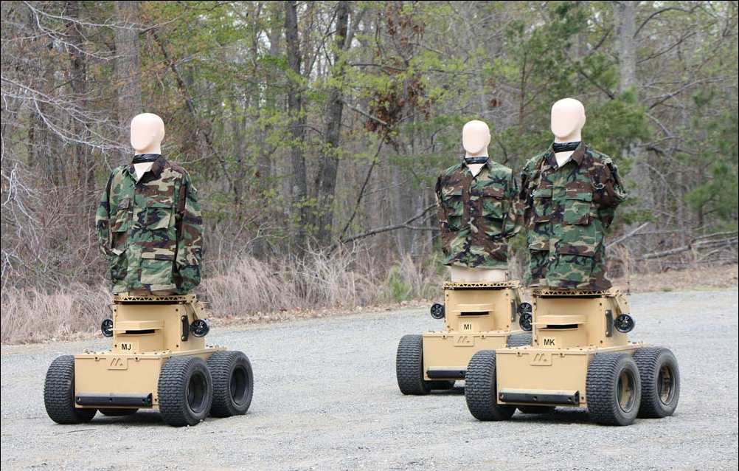
Further Development
Full Scale Model Capability
Longer Operational Uptime
More Visible Target
Larger Size to Accommodate Expansion
Further Peripheral Expansion
Computer Vision Manual Mode
LED array for Visual Hit Confirmation
More Accurate GPS and Encoder

Slide 13
Acknowledgements
Dr. Ping Liang
Dr. Madhi Maaref
Dr. Kimia Shamaei

